Slide 1
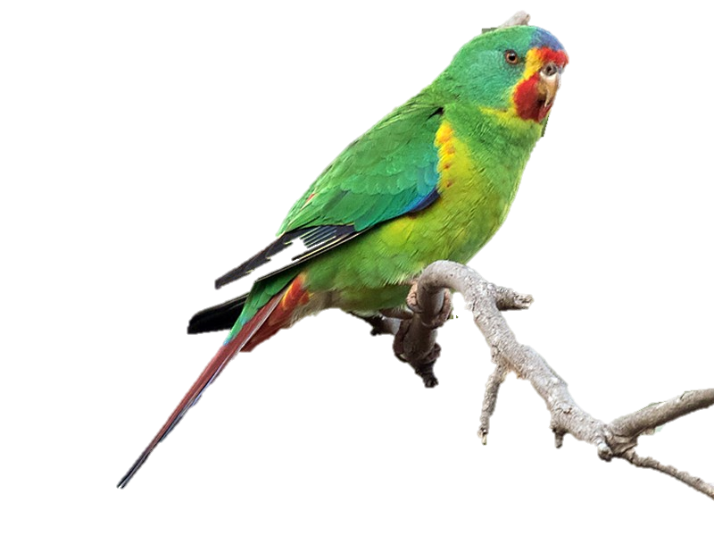
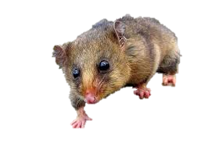
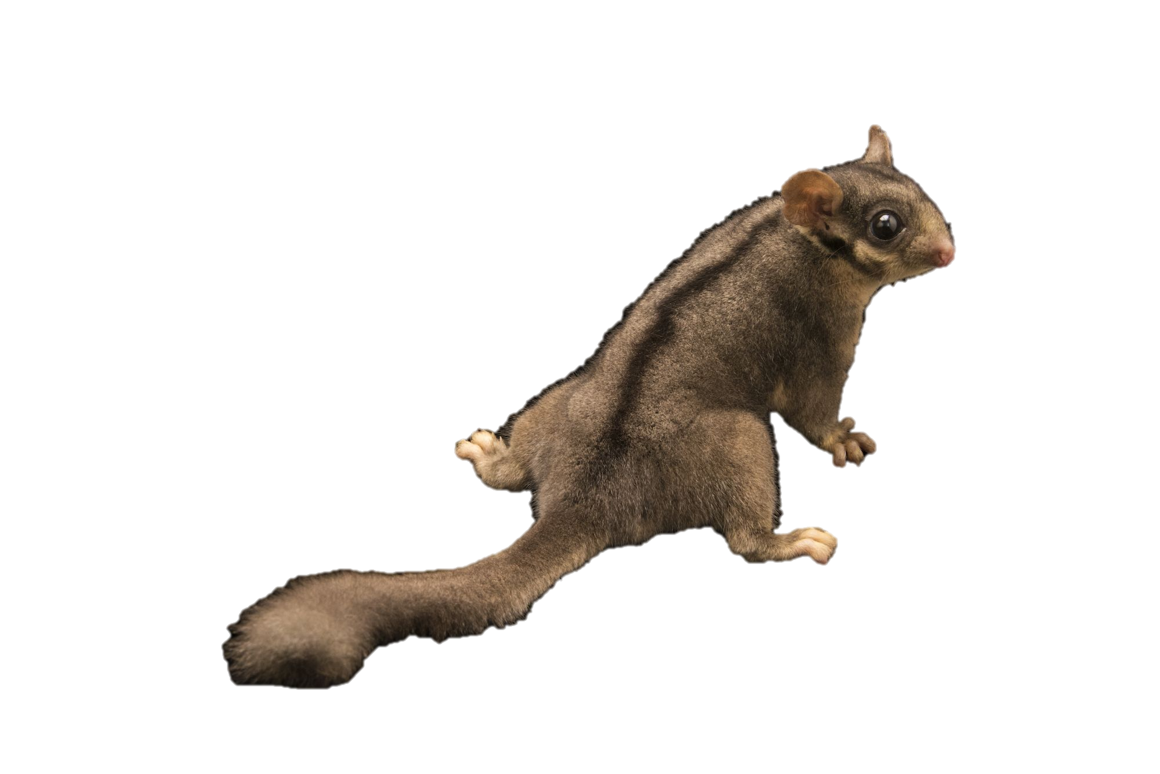
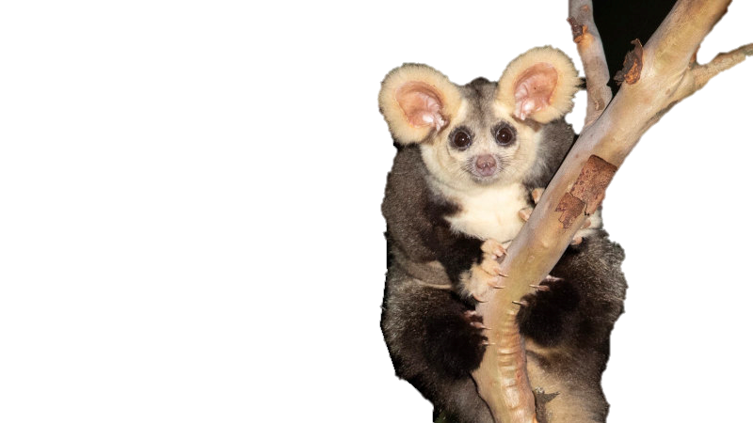
Tracey
the Swift Parrot
Fantastic (and endangered) Beast$ and Where to Find Them
Kat
the Mountain
Pygmy- Possum
Ruohong
the Leadbeater Possum
Pooja
the Greater Glider
Notes:
Swift parrot – Tracey
Greater glider – Pooja
Leaderbeater’s possum – Ruohong
Pygmy possum - Kat

Slide 2
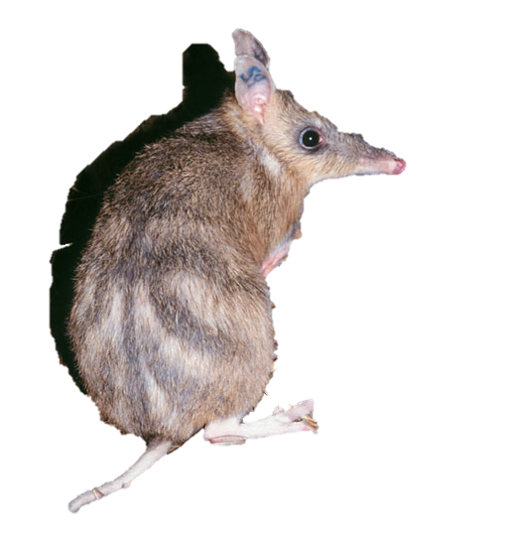
Why fantastic and endangered beast$?
Victoria is home to 12 threatened species of native animals. Some of these are extremely rare to sight in the wild.
The Department of Environment, Land, Water and Planning (DELWP) tracks sightings of these rare animals as part of their conservation efforts. The data is collected and collated into the Victorian Biodiversity Atlas.
With travel restrictions outside of Australia and potentially even interstate, it is a great opportunity for Victorians to explore the great outdoors and go animal spotting.
We wanted to create an easy reference to show explorers where and when they are most likely to sight these rare and fantastic beasts.
Eastern Barred Bandicoot
Notes:
Kat

Slide 3
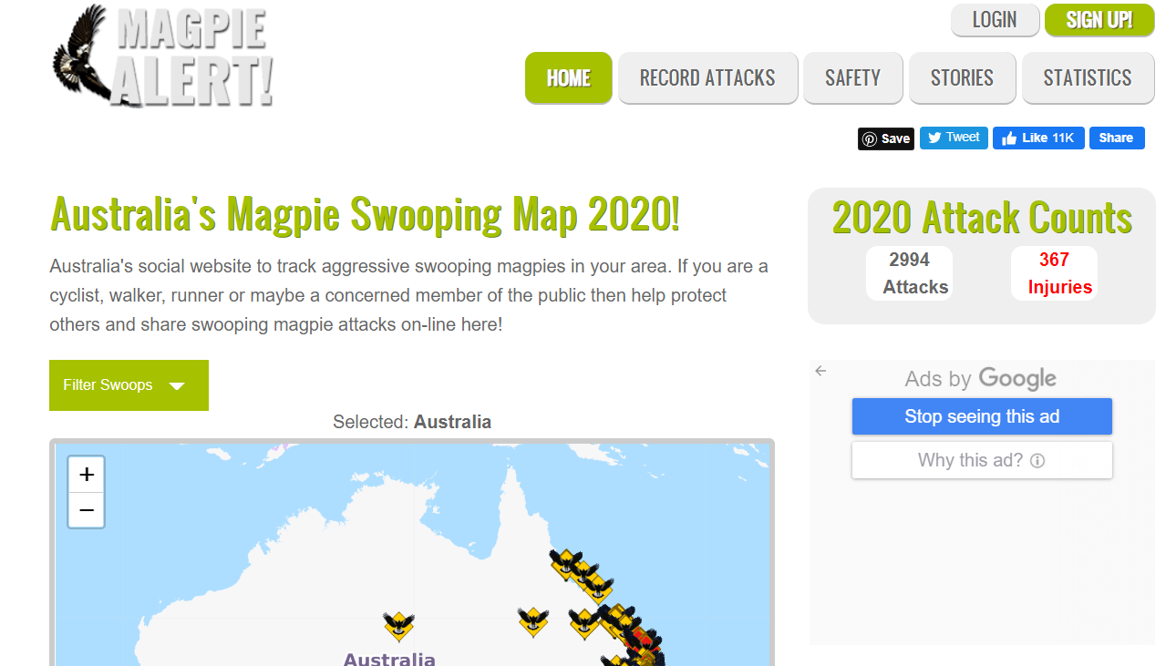
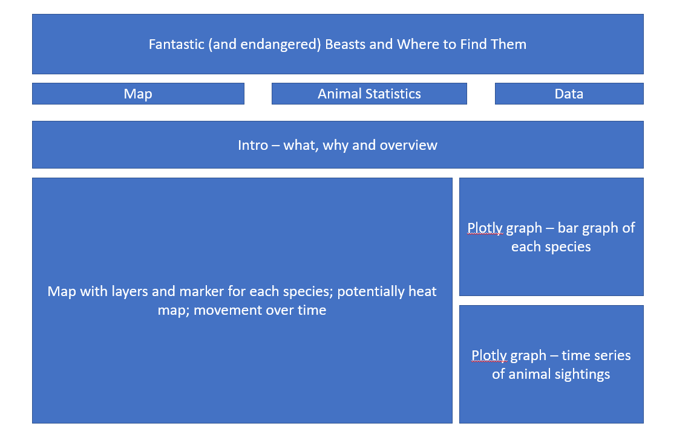
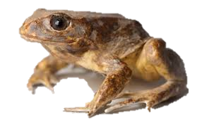
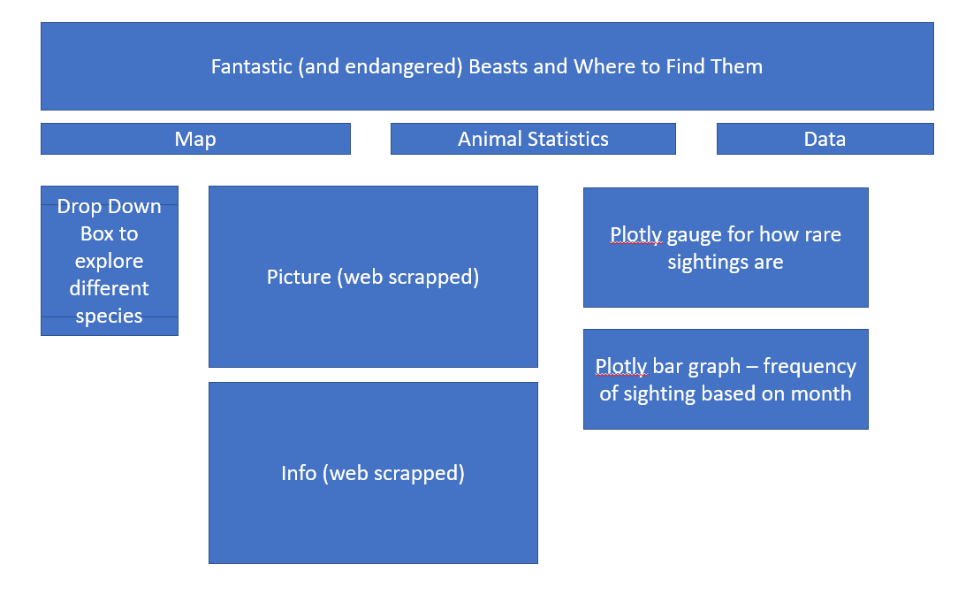
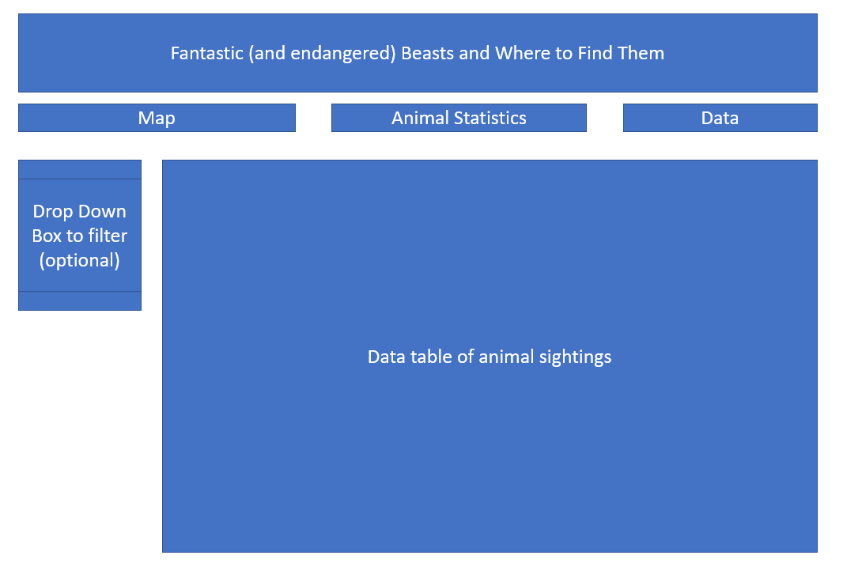
Concept art for fantastic and endangered beast$
In designing our website, we researched similar pages to identify the most user-friendly format to guide animal seekers on their journey.
We were inspired by the Magpie Alert page – https://www.magpiealert.com/
We then developed a sketch of our website with planned visualizations and information to be included.
Baw Baw Frog
Notes:
Kat

Slide 4
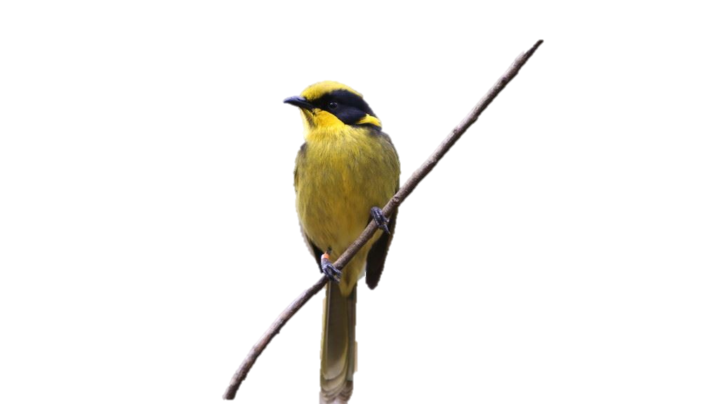
Data sources and where to find them
Data source$ and where to find them
Victorian Biodiversity Atlas
https://services.land.vic.gov.au/SpatialDatamart/dataSearchViewMetadata.html?anzlicId=ANZVI0803004161&extractionProviderId=1
This dataset contains animal sightings for the last 30 years.
Each sighting includes the date, time, location, animal type and the type of sighting.
Local Government Area
https://services.land.vic.gov.au/SpatialDatamart/dataSearchViewMetadata.html?anzlicId=ANZVI0803003519&extractionProviderId=1
This dataset contains information on local government area boundaries.
This could be used to identify municipalities as a map layer.
Zoos Victoria
https://www.zoo.org.au/fighting-extinction/local-threatened-species/
This website provides photos and information on each threatened species.
This could be used to provide information on each animal for the dashboard page.
Parks and Conservation Reserves https://services.land.vic.gov.au/SpatialDatamart/dataSearchViewMetadata.html?anzlicId=ANZVI0803004883&extractionProviderId=1
This dataset contains information on national parks (location and name).
This could be used for a map layer to identify whether a sighting is within a national park.
Helmeted Honeyeater
Notes:
Ruohong

Slide 5
Magical trick$ with data
Data Cleansing
Data Transformation
Web Scraping
Notes:
Tracey

Slide 6
Magical trick$ with data
Creation of MongoDB
Creation of JSON file
Notes:
Tracey

Slide 7
Visualization wizardry (aka Viz Wiz)
Description of approach to map
Notes:
Ruohong

Slide 8
Visualization wizardry (aka Viz Wiz)
Description of approach to dashboarding
Screen capture of the app (video) or screen shot
Notes:
Pooja

Slide 9
Visualization wizardry (aka Viz Wiz)
Description of approach to data filtering
Screen capture of the app (video) or screen shot
Notes:
Kat

Slide 10
Other things we would like to have done
Difficulties
Things done differently
Add info about animals
Extra Javascript library
Notes:
Pooja

